Slide 1
Describing Data: Numerical Measures
Chapter 3

Slide 2
Introduction
Measures of central tendency (location)
  Mean (average, or arithmetic mean);
  Median;
  Mode;
  Geometric mean;
Measures of dispersion (variability)
  Range;
  Mean deviation;
  Variance;
  Standard deviation;
  Quartiles, deciles, and percentiles;
  Measures of shape: Skewness; Box plots;
  Measures of central tendency and variability: Grouped data

Slide 3
Measures of central tendency – mean
Measures of central tendency yields information about the center, or middle part, of a group of numbers;
Arithmetic mean is the average of a group of numbers
  population mean µ
  sample mean
Weighted mean: a special case of the arithmetic mean, it occurs when several observations are of the same value

Slide 4
Mean (average)
Population mean;
= sum of all the values in the population/number of values in the population
Sample mean;
= the sum of all the values in the sample/the number of values in the sample:
Weighted mean;
The weighted mean of a set of numbers X₁, X₂, ..., Xn, with corresponding weights w₁, w₂, ...,w_{n}, is computed from the following formula:

Slide 5
Mean - Example 1
The Kiers family owns four cars. The following is the current mileage on each of the four cars:
56 000, 23 000, 42 000, 73000
Find the mean.

Slide 6
Example 1 - Answer

Slide 7
Mean - Example 2
A sample of five executives received the following bonus last year ($1000):
14.0, 15.0, 17.0, 16.0, 15.0
Find the mean

Slide 8
Mean - Example 3
During a one hour period on a hot Saturday afternoon Chris served fifty drinks. He sold five drinks for $0.50 each, fifteen for $0.75 each, fifteen for $0.90 each, and fifteen for $1.15 each. Compute the weighted mean of the price of the drinks.

Slide 9
Measure of location - Median
The Median is the middle value in an ordered array of numbers: 5 4 9 13 11=>4 5 9 11 13=> 9 is the median;
For an odd set of values, the median is the middle number;
For an even set of values, the median will be the average of the two middle numbers.

Slide 10
Median
Example 1
The ages for a sample of five college students are:
21, 25, 19, 20, 22
Arranging the data in ascending order gives: 19, 20, 21, 22, 25. Thus the median is 21.

Slide 11
Median
Example 2
The penalty minutes of four hockey players are:
76, 73, 80, 75
Arranging the data in ascending order gives: 73, 75, 76, 80. Thus the median is 75.5, found by (75+76)/2.

Slide 12
Measure of location - Mode
The mode is the value of that appears most frequently in a set of data. It tells where most data are clustered.
EXAMPLE : The exam scores for ten students are: 81, 93, 84, 75, 68, 87, 81, 75, 81, 87. Because the score of 81 occurs the most often, it is the mode.
In business, mode often is used to determine sizes of clothing, and preferences.

Slide 13
Measure of location - Mode
If two most frequently occurring value => bimodal;
If more than two most frequently occurring value => multimodal;

Slide 14
Measure of location - Geometric mean
The geometric mean (GM) of a set of n numbers is defined as the nth root of the product of the n numbers, . The formula is:
Application 1: find the average of percentage increases;
Ex: 5% increase in salary this year and a 15% increase next year. What is the average annual percentage increase? 10%, no, it’s 9.886%.
Note, for negative percentage such as -40%, use 1.0 -0.4 = 0.6 in the formula.

Slide 15
Geometric mean
Example 1
The percent increase in sales , for the last five years at Combs Cosmetics are 8, 12, 14, 26 and 5, find the average percentage increase.

Slide 16
Example 1- Answer

Slide 17
Geometric mean
Example 2
The interest rate on a bond for 3 successive year was 5%, 41%, and 4%, find the average interest rate x.
Then the average interest rate is 15.47%.
For the above example: the arithmetic mean is (1.05+1.41+1.04)/3 = 1.1667 or 16.67%
The GM gives the true average rate of return, while the arithmetic mean would overstates the true average.

Slide 18
Geometric mean
Application 2: calculate the percent increase from one time period to another, given the beginning value and end value.
Bi-weekly income increases from $2000 to $3000 from end of 2005 to end of 2007, what is the annual percentage increase?
Notes:
22.47%

Slide 19
Geometric mean
Example
The total population of British Columbia increased from 3,874,276 in 1995 to 4, 254,522 in 2005, find the annual population increase?
That is, the annual population increase is 0.941%.

Slide 20
Exercise 1
For a sample of 10 households, the following are the number of people living in each household:
  2, 3, 1, 2, 6, 4, 2, 1, 5, 3;
  Compute the mean, median, mode;
The percent increase in sales, for the last four years at Combs Cosmetics are: 4.91, 5.75, 8.12, and 21.60.
  Find the geometric percent increase;
  Find the arithmetic percent increase;
  Is the arithmetic mean equal to or greater than the geometric mean?
Notes:
2.9, 2.5, 2; About 8.39%; about 10.095%;greater

Slide 21
Measures of dispersion
Range;
Mean deviation;
Variance;
Standard deviation;
Skewness;
Quartiles, deciles, and percentiles

Slide 22
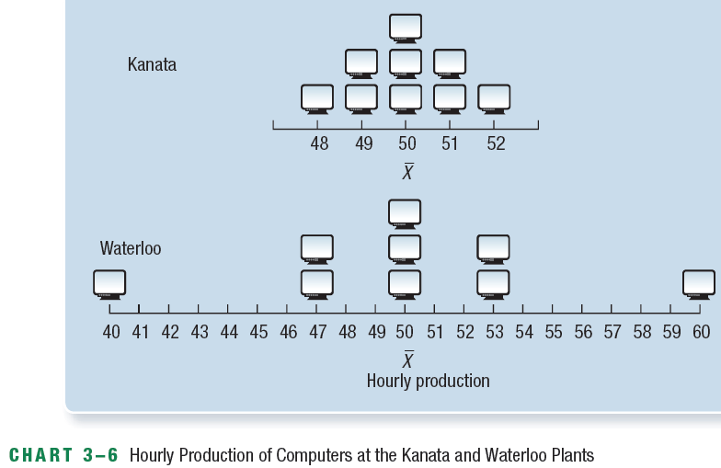
Why study dispersion
Measure how wide the data are distributed;
Comparing two distributions that might have the same mean, median and mode;

Slide 23
Measures of dispersion - Range
The range is the difference between the largest and the smallest value.
Only two values are used in its calculation.
It is influenced by extreme values only.

Slide 24
Range
Example
The number of books sold in a bookstore during the five days of a week are:
105, 97, 101, 106, 103
Find the range and the mean.
Range = 106 – 97 = 9
Mean = (105+97+101+106+103)/5=512/5=102

Slide 25
Measures of dispersion - Mean deviation
The Mean Deviation is the mean of the absolute values of the deviations from the arithmetic mean.
Where : x is the value of each observation.
is the arithmetic mean of the values.
n is the number of observations in the sample.
| | indicates the absolute value.
MD tells us the average distance between X and its mean. Example: hourly production (48, 49, 50, 51, 52) and (40, 47, 50, 53, 60), the larger the MD is, the wider(higher) the dispersion (variability) is.

Slide 26
Mean deviation
105, 97, 101, 106, 103, find the MD.
To find the mean deviation, first find the average sales:
The MD is:

Slide 27
Mean deviation
Pro: MD uses all the values in the computation, comparing range;
Con: absolute value is difficult to work with => in stead of taking absolute values, we take squares of the deviations=> variance

Slide 28
Variance and standard deviation
The population variance is the arithmetic mean of the squared deviations from the population mean.
or
is called sigma squared.
is the arithmetic mean of the population.
is the value of an observation.
is the number of observations.

Slide 29
Variance and standard deviation
Population standard deviation is the square root of the population variance
If the population variance is 236, the population standard deviation is 15.36, found by

Slide 30
Variance and standard deviation
Sample variance
Or
Sample deviation

Slide 31
Variance
Pro: easier to compute than MD;
Con: variance is expressed in squared units of measurement, which is difficult to interpret. Example, production cost in squared dollars => need of standard deviation, which is the square root of variance;

Slide 32
Variance and standard deviation-Example 1
The hourly wages earned by a sample of five students are:
$7, $5, $11, $8, $6, find the sample SD.

Slide 33
Variance and standard deviation Example-2
The ages of the Dunn family are:
  2, 18, 34, 42
  What is the population variance?
Notes:
Standard deviation =15.36 yr.

Slide 34
The coefficient of variation
The coefficient of variation is the ratio of the standard deviation to the arithmetic mean, expressed as a percentage.
CV is useful in comparing variability for data with different units: comparing a set of annual income with CV=18% with the length of service with CV=29%; No comparison using variance or standard deviation due to different units.
It is also sometimes used as a measure of risk in stock market.
Five weeks average prices for stock A are 57,68,64,71,62, mean=$64.4, sd=$4.84, CV=7.5%;
Five weeks average prices for stock B are 12, 17, 8, 15, and 13, mean=$13, sd=$3.03, CV=23.3%.
Which stock is more risky using price variability as a measure of risk?

Slide 35
Quartiles, Deciles, and Percentiles
Median divide all the observations into two parts;
Quartiles divide them into four parts;
Deciles divide them into 10 parts;
Percentiles divide them into 100 parts;
Location of a percentile:
Note: order data first;

Slide 36
Quartiles, Deciles, and Percentiles
Determine the median and the values corresponding to the first and third quartiles in the following data:
46 47 49 49 51 53 54 54 55 55 59
Interquartile Range (IQR)
The IQR =Q₃ - Q₁ =55-49=6, it includes the middle 50 percent of the observations. It is useful when we are more interested in the middle part of the data => Real estates.

Slide 37
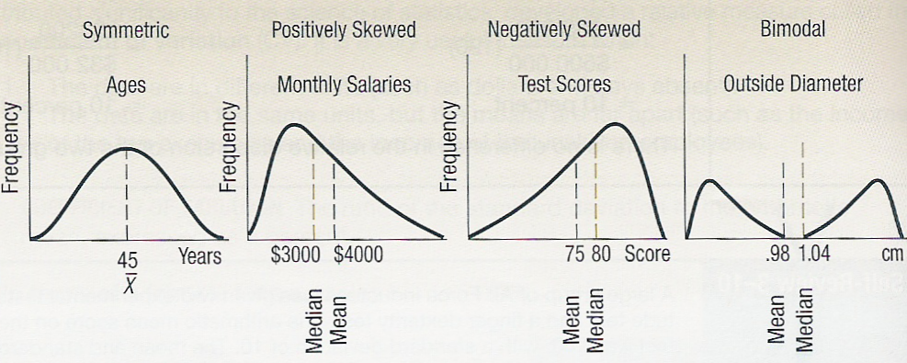
Measures of shape - Skewness
Skewness is the measure of the lack of symmetry of the distribution

Slide 38
Skewness
The coefficient of skewness can be calculated using:
Where sd is standard deviation;
sk can range from -3.00 up to 3.00.
A value of 0 indicates a symmetric distribution. When sk <0, negatively skewed; When sk >0, positively skewed.

Slide 39
Skewness -Example
A sample of five data entry clerks employed in the customer service department of a large pharmaceutical distribution company revised the following number of records last hour: 73, 98, 60, 92, and 84.
Find the mean, median, and the stand deviation;
Compute coefficient of skewness;
What is your conclusion regarding the skewness of the data?
Mean: 81.4; Median: 84; SD: 15.19;
Sk = 0.51;
Positively skewed;

Slide 40
Box Plots
A box plot is a graphical display, based on quartiles, that helps to picture a set of data.
Five pieces of data are needed to construct a box plot: the minimum value, the first quartile, the median, the third quartile, and the maximum value.

Slide 41
Box plots
20 pizza delivery generated the following data:
Min value = 13 min
Q1=15 min
Median = 18 min
Q3= 22min
Max value =30 min

Slide 42
Box Plots
The uses of box plots:
Find outliers if any, values outside of Q₁-1.5IQR to Q₃+1.5IQR
to determine whether a distribution is skewed=>median on the right side of the box, then negatively skewed; median on the left side, then positively skewed.

Slide 43
Grouped data
Measures of central tendency: Mean; Median; Mode;
Measures of variability: variance and standard deviation;

Slide 44
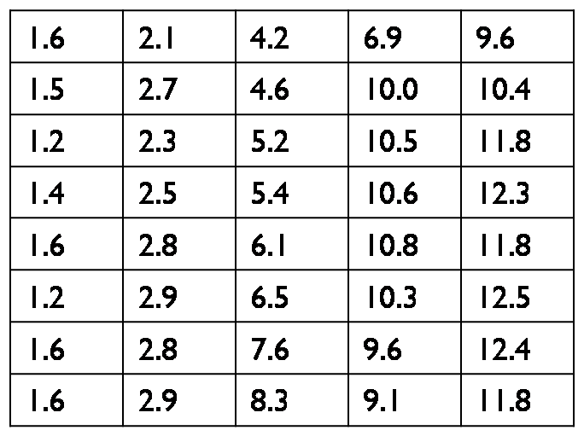
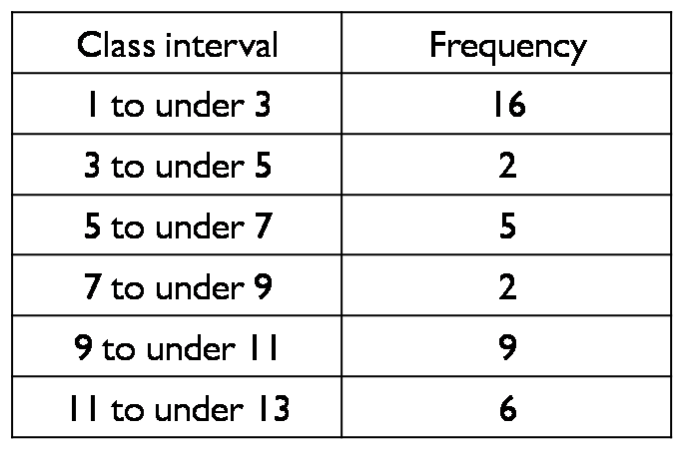
Grouped data - Mean
The table gives the unemployment rate over the past 40 years;
Use midpoint of each class interval => similar to the calculation of weighted mean
Mean = (2×16+4×2+6×5+8×2+10×9+12×6)/40=6.2%

Slide 45
Grouped data - Median
Median: the value attributed to the middle point of the data.
Middle point:
L_{p} = (n+1)P/100=20.5; Median =
Where L is the lower point of the class containing the median; L=5%
f is the frequency of the class containing the median; f=5;
f_{c} is the cumulative frequency of classes preceding the class containing the median; f_{c} = 16+2 =18;
i is the width of the class containing the median, i=7-5=2%
Median =

Slide 46
Grouped data - Mode
The class midpoint of the modal class (the interval with the highest frequency).
Modal class is 1 to under 3, therefore,
Mode: 2%

Slide 47
Grouped data - Variability
Class interval | f | M | fM | fM²
1-under 3 | 16 | 2 | 32 | 64
3-under 5 | 2 | 4 | 8 | 32
5-under 7 | 4 | 6 | 24 | 144
7-under 9 | 3 | 8 | 24 | 192
9-under 11 | 9 | 10 | 90 | 900
11-under 13 | 6 | 12 | 72 | 864
Total |  |  | 250 | 2,196
Population variance and standard deviation
Original formula Computational Version
Where M is the midpoint of each class.

Slide 48
Grouped data - Variability
Sample variance and standard deviation
Original formula Computational Version

