Slide 1
Describing data: Frequency distribution and graphic presentation
Chapter 2

Slide 2
Goals
Introduce the graphical presentation of data: bar graph, line graph and pie chart;
Learn how to use frequency distribution to describe data;
How to present frequency distribution using graphs: histogram; polygon;
Stem-and-leaf displays;

Slide 3
Graphical presentation of data
Bar chart;
Line chart;
Pie chart;

Slide 4
Example
  Construct a bar chart for the number of unemployed per 100,000 population for provinces during 2001.
Province | # unemployed / 100,000
Newfoundland and Labrador | 16100
Prince Edward Island | 11900
Nova Scotia | 9700
New Brunswick | 11200
Quebec | 8700
Ontario | 6300
Manitoba | 5000
Saskatchewan | 5800
Alberta | 4600
British Columbia | 7700

Slide 5
Bar Chart for the Unemployment Data

Slide 6
Line Chart for the Unemployment Data

Slide 7
EXAMPLE
A sample of 200 runners were asked to indicate their favorite type of running shoe. Draw a pie chart based on the following information.

Slide 8
Pie Chart for Running Shoes

Slide 9
An Example of frequency distribution
Dr. Tillman is Dean of the School of Business. He wishes to prepare a report showing the number of hours per week students spend studying. He selects a random sample of 30 students and collects the number of hours each student studied last week.
15.0, 23.7, 19.7, 15.4, 18.3, 23.0, 14.2, 20.8, 13.5, 20.7, 17.4, 18.6, 12.9, 20.3, 13.7, 21.4, 18.3, 29.8, 17.1, 18.9, 10.3, 26.1, 15.7, 14.0, 17.8, 33.8, 23.2, 12.9, 27.1, 16.6.

Slide 10
An Example of frequency distribution
Frequency distribution is a summary of data presented in the form of class intervals and frequencies.
The class intervals are mutually exclusive: an observation is included in only one class interval or category;

Slide 11
How to construct frequency distribution
Key questions:
  How to choose the lower limit of the first class interval?
  How many class intervals?
  What is the range of the class interval?

Slide 12
How to construct frequency distribution
How to choose the lower limit of the 1st class interval?
The lower limit is often a number close to the minimum and is rounded up to some convenient number such as 5, 10, 100,,,
Using these rules, 10 is chosen for Min =10.3.

Slide 13
How to construct frequency distribution
How to choose the number of class intervals k?
Use 2 to the k rule – select the smallest number (k) such that 2^{k} is greater than the number of observations (n=30).
Choose the smallest k such that 2^{k} > 30
k = 5

Slide 14
How to construct frequency distribution
How to choose the range of class intervals i?
i≥ (Max-Min)/k
Max=33.8, Min=10.3, k=5, therefore, i≥4.7, round up and i=5
In general, we use equal class intervals.

Slide 15
Result – Frequency Distribution

Slide 16
Summary
How to construct frequency distribution?
  Set the lower limit of the first class.
  Decide on the number of classes k using 2 to the k rule.
  Determine the class interval using i≥ (Max-Min)/k.
  Count the number of data in each class => calculate the frequency.

Slide 17
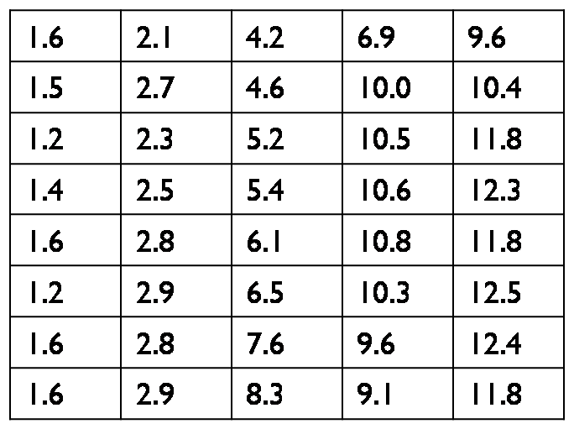
Construct frequency distribution – Exercise 1
Construct the frequency distribution of unemployment rate for France over 40 years, using the rules that you have just learned.

Slide 18
Unemployment rate for France over 40 years
Frequency Distribution
1.6 | 2.1 | 4.2 | 6.9 | 9.6
1.5 | 2.7 | 4.6 | 10.0 | 10.4
1.2 | 2.3 | 5.2 | 10.5 | 11.8
1.4 | 2.5 | 5.4 | 10.6 | 12.3
1.6 | 2.8 | 6.1 | 10.8 | 11.8
1.2 | 2.9 | 6.5 | 10.3 | 12.5
1.6 | 2.8 | 7.6 | 9.6 | 12.4
1.6 | 2.9 | 8.3 | 9.1 | 11.8
Class interval | Frequency
1 to under 3 | 16
3 to under 5 | 2
5 to under 7 | 5
7 to under 9 | 2
9 to under 11 | 9
11 to under 13 | 6

Slide 19
Construct frequency distribution – Exercise 2
A set of data contains 53 observations. The lowest value is 42 and the largest is 129. The data are to be organized into a frequency distribution.
a. How many classes would you suggest?
b. What would you suggest as the lower limit of the first class?
Notes:
a. k=6; b. 40;

Slide 20
Cumulative frequency distribution

Slide 21
Graphic presentation of a frequency distribution - Histogram
A histogram is a bar graph where the classes are marked on the horizontal axis and the class frequencies on the vertical axis. The width of the bar is the class width and the height of the bar is the frequency of the class. The bars are drawn adjacent to each other.

Slide 22
Graphic presentation of a frequency distribution – Frequency Polygon
A frequency polygon consists of line segments connecting the points formed by the intersections of the class midpoints and the class frequencies.

Slide 23
Stem and Leaf Plots
A stem and leaf plot is constructed by separating the digits for each number of the data into two groups, a stem and a leaf.
Stem – the leftmost digit;
Leaf – the rightmost digit;

Slide 24
Safety exam scores for plant trainees
86 | 77 | 91 | 60 | 55
76 | 92 | 47 | 88 | 67
23 | 59 | 72 | 75 | 83
77 | 68 | 82 | 97 | 89
81 | 75 | 74 | 39 | 67
79 | 83 | 70 | 78 | 91
68 | 49 | 56 | 94 | 81
stem | leaf
2 | 3
3 | 9
4 | 7 | 9
5 | 5 | 6 | 9
6 | 0 | 7 | 7 | 8 | 8
7 | 0 | 2 | 4 | 5 | 5 | 6 | 7 | 7 | 8 | 9
8 | 1 | 1 | 2 | 3 | 3 | 6 | 8 | 9
9 | 1 | 1 | 2 | 4 | 7

Slide 25
Stem and Leaf Plots
Pros 1: the values of the original raw data are retained;
Pros 2: easy to see whether the scores are in the upper or lower end of each bracket and also determine the spread of the scores.

