Slide 1
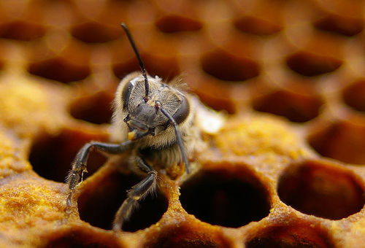
Colony Collapse disorder

Slide 2
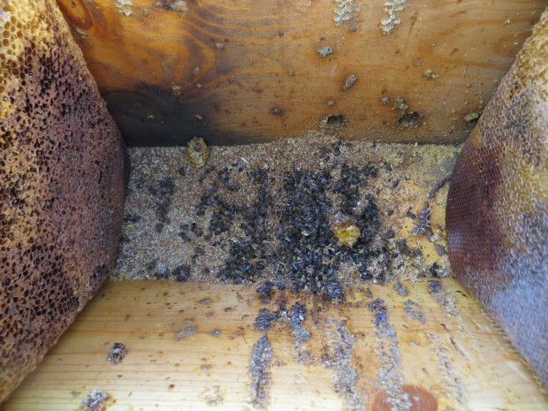
Symptoms of CCD
In an already collapsed colony
Complete absence of adult bees with little or no build-up of dead bees in or around colonies (bees seem to disappear)
Presence of capped brood in colonies
Presence of food stores
Not immediately robbed by other bees
Hive pests such as wax moth and small hive beetle delay when they attack hive after CCD
Previously of 5-10% loss of colonies by bee keepers was normal now over 20% loss is normal and some areas are closer to 30%
In Colony that appears to be collapsing
Insufficient work force
Workforce that is present made up of mostly young bees
Queen is present
The cluster is reluctant to consumed provided food

Slide 3
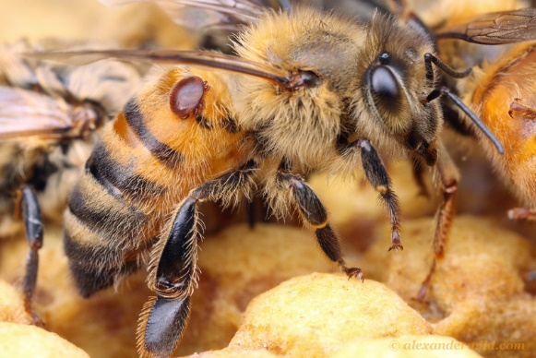
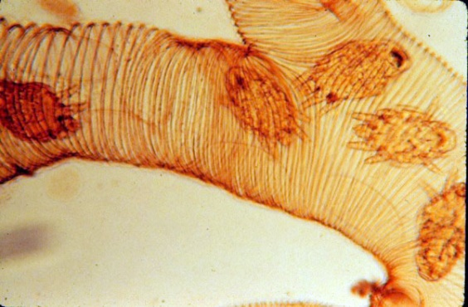
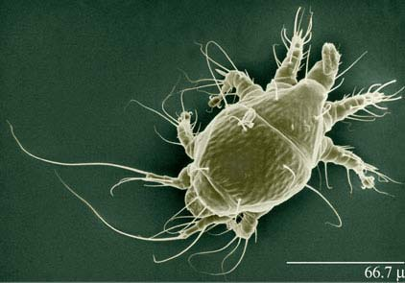
Potential Causes of CCD
Pathogens and Parasites
Varroa destructor - Honey bee mite
Acarapis woodi - Tracheal mite
Nosema apis/ceranae – Intestinal microsporidian
Israeli acute paralysis virus (IAPV)
Human and Environmental factors
Human care
Pesticides

Slide 4
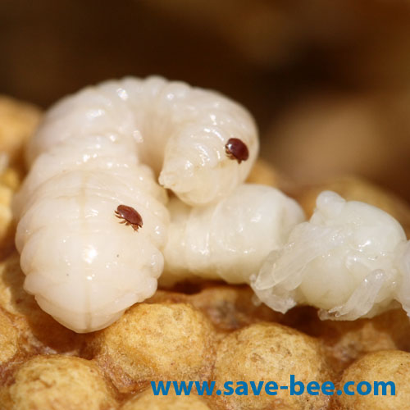
Potential Causes of CCD
Varroa destructor
Invasive parasite from Asian honey bees
Strong suspect in CCD but not the direct cause
Detrimental physical and physiological effects and potentially suppresses the immune system of the host allowing other pathogens to multiply.
Visually detectible and not present in all CCD cases
Moved to European honey bees who do not have the grooming behavior and resistance to the mites
External parasite that sucks hemolymph of honey bees and can spread pathogens
Also infects young bees (relative size on humans is a watermelon)
Heavy infections can cause death
Variety of mitecides have been used but V.destructor has developed resistance to many.
Was absent from Vancouver Island until 1993 when it was brought in on illegal hives from the mainland
Man was charged and sentenced to large fines and prison time

Slide 5
Potential Causes of CCD
Acaris Woodi
Infects tracheal tubes of honey bees
Pierce tracheal tubes and suck hemolymph
Very hard to detect
Can only be seen under a microscope
More than 100 mites can populate the tracheal tubes and can severely weaken the bees
Nosema apis/ceranae
Microsporidians that infect the midgut of bees
Cause dysentery (diarrhea) and early senescence (aging) of adult workers
Obvious due to dysentery
Potentially one of the primary causes of CCD
Acaris woodi
Nosema apis

Slide 6
Potential Causes of CCD
Israeli acute paralysis virus (IAPV)
One of the primary candidates for causing CCD
Present in 96.1 % of CCD
3rd most common virus in honey bees
Definitely a marker for CCD however, it may not be a cause and more of a symptom.
RNA virus that concentrates in the gut, hypopharyngeal glands and nerve tissue but infects throughout the body
Presence of virus in hypopharyngeal glands promotes spreading through colony in royal jelly and honey
Infected bees show shivering symptoms and parlysis which are typical symptoms of nervous system impairment
Shown to be transmitted by V.Destructor

Slide 7
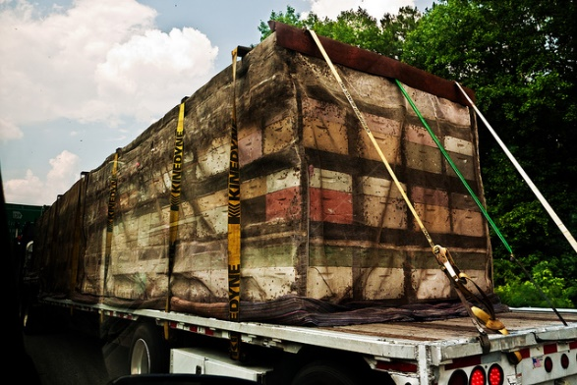
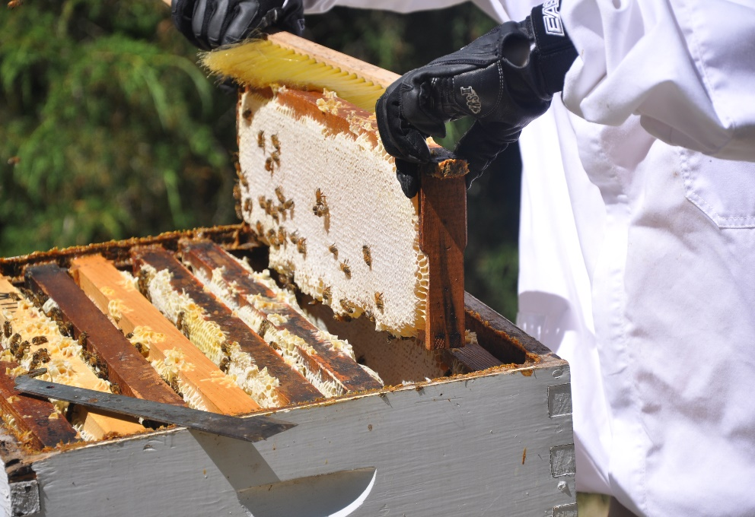
Potential Causes of CCD
Human Care
Most honey bee colonies are in agriculture
Colonies are moved field to field to fertilize crops
Movement stresses the bees by changing the temperature and general agitation from movement of hive
When in transit adult honey bees that would normally be foraging for food are in closer contact with younger bees
Older bees have had a longer time to become infected with parasites and pathogens and this could increase transmission within the hive
Removal of honey
Potential but unlikely cause of CCD
Bees need a certain amount of honey to survive the winter when there are no flowering plants to collect honey from
If bee keepers remove too much honey can cause colony to starve during winter
Too simple and would not be show the widespread distribution of CCD

Slide 8
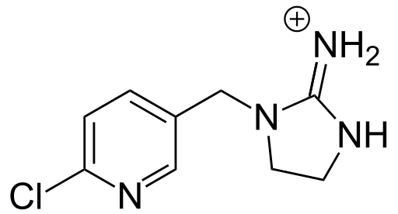
Potential Causes of CCD
Pesticides
Pesticides are used within honey bee colonies to control hive pests such as V. destructor
By themselves the pesticides are fairly harmless however, studies have shown that combinations of pesticides can have detrimental effects on the honey bees ability to fight off pathogens
Interferres with bees’ detoxification process and can seriously weaken immune system of bees. This increases the chances bees will get infected by other pathogens
V. destrutor has developed a resistance to many of the pesticides previously used to control them
This resistance has forced bee keepers to try no forms of control or potentially higher doses of pesticides which can harm the bee colony
Plant insecticides
Insecticide commonly used on plants such as neonicotinoidscan have adverse effects on bees
neonicotinoidshave shown to pass through plants into their flowers and will deposit into their pollen
The level in the pollen is below lethal for bees but sustained exposure could have detrimental effects
Has shown to have effects on navigation and foraging abilities of honey bees

Slide 9
So what is the actual cause of CCD?
Short-Answer: We don’t know
There is no straight forward answer, most likely cause is a combination of a some or all of the described potential causes
Combinations of stress, pesticides and parasites weaken the immune system and hive
The weakened individuals and hive are more likely to become infected with other pathogens that are always present but can be held off by health bees
During the winter when the hive is less active and more vulnerable the colony collapses and the bees die or disappear.

Slide 10
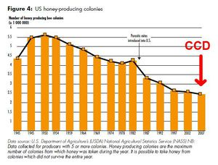
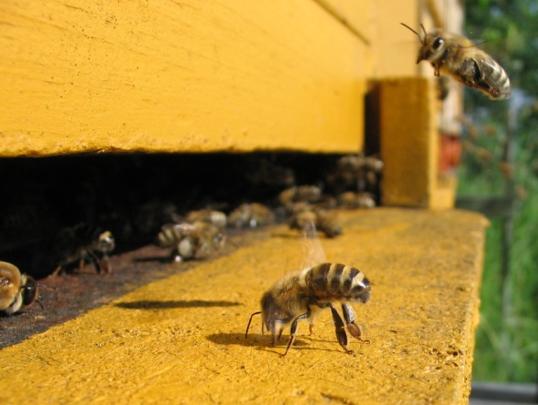
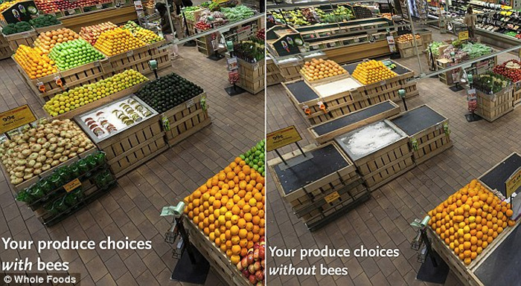
Economic and Ecological Impacts of CCD
Economic Impacts
Economic significance of honey bees
Colony losses due to CCD
Agricultural impacts
Ecological Impacts
Impact of CCD on the environment

Slide 11
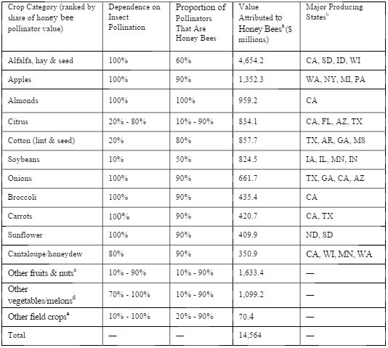
Economic Impacts of CCD
Honey Bees are thought to be the most economically important pollinators world wide.
The value of honey bees as commercial pollinators is estimated to be approximately $15 Billon annually.
There are 2.4 million bee colonies in the United States, which provide pollination to over 90 commercial crops.
In the US bee pollination accounts for approximately one-third of diet.
Contributing to the production a variety of fruits, vegetables, tree nuts and crops.
Everyday fruits and vegetables such as apples, blueberries, broccoli, cauliflower and celery depend almost entirely (90-100%) on bee pollination.

Slide 12
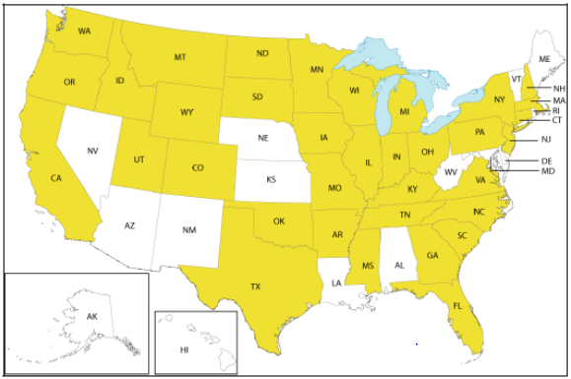
Economic and Ecological Impacts of CCD
Losses due to CCD
In 2006/2007 losses due to CCD were reported in 35 US States, 5 Canadian provinces and several European countries.
Approximately 25% of bee keepers were impacted.
From 2006-2011 annual honey bee losses due to CCD were an average of 33%, with reports as high as 90%.

Slide 13
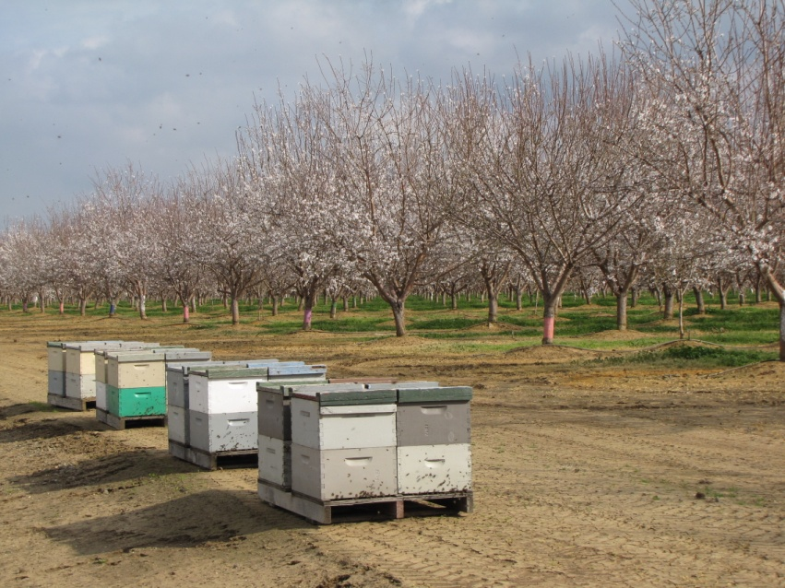
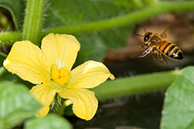
Economical and Ecological Impacts of CCD
Agricultural Impacts
CCD has caused major impacts on the agricultural industry. Resulting in rising costs of pollination services and higher food prices.
Of the 2.4 million bee colonies, 1.3 million are used for the production of the California almond crop.
This crop has suffered dramatically due to CCD, resulting in poor crop yields and steep price increases.

Slide 14
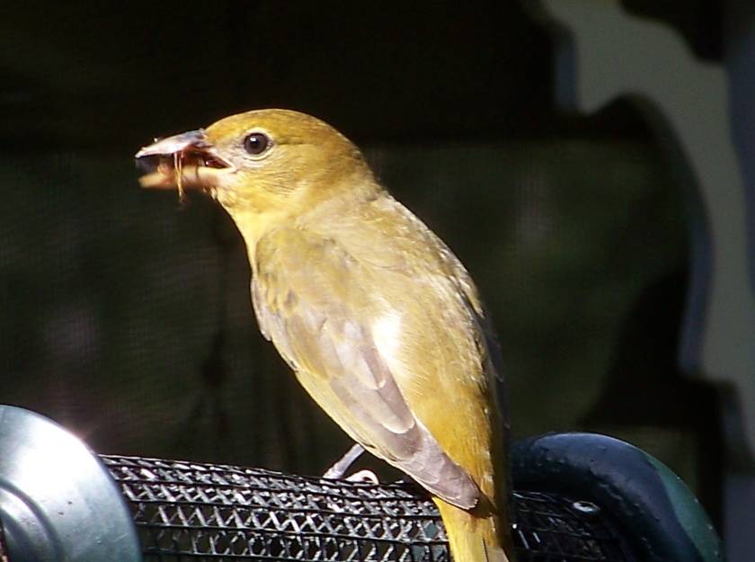
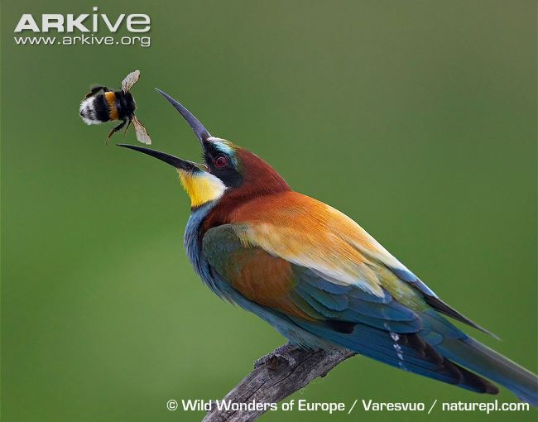
Economical and Ecological Impacts
Impact on the environment
Over 200, 000 plant species around the world require pollinators in order to reproduce and survive.
Over the past two decades there has been a sever decline in the abundance of pollinators.
This however is due to several different factors including climate change, disease, habitat loss and pesticide exposure. Therefore CCD is only a small contributing factor to the problem.
Many ecosystems consider bees and other pollinators as valuable contributors to the food web. The loss of these species could result in significant losses for pollen dependant flowers along with losses of a valuable food source for higher trophic levels.
Pollen limitation on seed set.
Plants are unable to produce the maximum seed yield due to inadequate pollen supply.

Slide 15
What is the status of CCD today?
Overall: Reports of CCD have been declining.
Winter losses for the past two years have been noticeably less than the previous nine years.
A steady decline in reports of CCD since its initial out break in 2007 has been seen in the United States, however colony loss is still a major concern.
Warmer winters may be a contributing factor to the decline in CCD.

Slide 16
Literature Cited
Grossman, E. 2013. Declining Bee Populations Pose A Threat to Global Agriculture. Yale Environment 360. Obtained from: http://e360.yale.edu/feature/declining_bee_populations_pose_a_threat_to_global_agriculture/2645/
Lu, C., Warchol, K. M., Callahan, R.A. 2014. Sub-lethal exposure to neonicotinoids impaired honey bees winterization before proceeding to colony collapse disorder. Bulletin of Insectology. 67(1). P:125-130. Obtained from: http://www.bulletinofinsectology.org/pdfarticles/vol67-2014-125-130lu.pdf
Richards, T. H., Blaylock, I. T. 2009. Honey Bees: Colony Collapse Disorder and Pollinator Role in Ecosystems. Nove Science Publishers, Inc. New York.
USDA: United States Department of Agriculture: Agricultural Research Sevice. 2015. Honey Bee Health and Colony Collapse Disorder. Obtained from: http://www.ars.usda.gov/News/docs.htm?docid=15572

