Slide 1
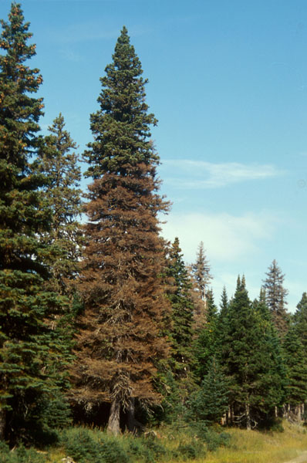
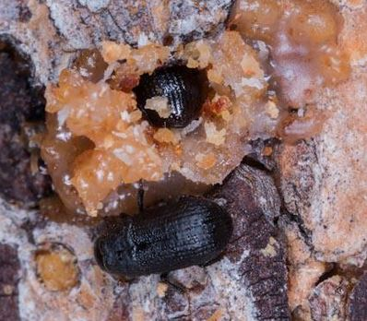
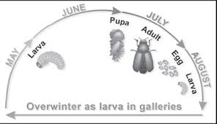
Western Spruce Beetle – Dendroctonus rufpennis
Mark Duncan & Colby Mahood
Introduction:
Western spruce beetle (IBS) is anticipated to be one of the next large issues to come in the forest industry, the media coverage of the expected infestation is portrayed as a disastrous event. This poster will use information from the government of British Columbia and other sources to shed light on the actual facts of the beetle. Western spruce beetle is a natural disturbance agent throughout the range of spruce. At endemic levels the spruce beetle normally only attacks downed trees, logging debris, decked timber, dying or stressed trees and can sometimes cause mortality. When a outbreak of Western spruce beetle occurs it will attack and cause mortality in live trees. By understanding the life cycle and the use of proper management strategies described in this poster, large outbreaks can be prevented and managed for.
Host and Range:
The Western spruce beetle, is known to attack Engelmann, Sitka, white and occasionally black spruce. IBS prefers stands that are made up of over 65% spruce in well drained creek bottoms. It is most commonly found throughout the range of spruce, but its largest concentrations are found in the Omineca, Skeena, Northeast and the Thomson Okanagan regions. Stats from an aerial overview survey conducted by the BC government found there to be 194,050 ha infected with western spruce beetle in 2015.
Damaging Agents & Detection:
Early detection may be through visual lose of green needles found beneath the seemingly live tree. Infested trees may have small pitch tubes from when the trees resin flows out of the holes that are bored by invading beetles. Green needles found below a live tree may also indicate an attack in early stages. After one to two years after initial attack, trees do not exhibit the red needles common to other beetle attacks, needles turn to a yellow-green colour instead. After three to four years, needles will then turn brown and fall to the ground. All these stages can be monitored through the use of aerial means, as well as ground surveys. The damage done to the lumber aspect is the blue stain fungus that the beetle carries, this results in a commercially undesirable traits in the lumber.
Life Cycle:
The life cycle of the western spruce beetle is often two years, but can vary from one to three years based on the geographical location, elevation, and temperature of the area. Come either late May or early July, females begin the attack by boring into host trees and releasing an aggregation pheromone which attracts both sexes and ensures mass attack on the host tree. Optimal host trees for the IBS are trees that are windthrown or downed trees in general, this is best for the beetle as the host defenses of the trees are little to non existent. Once larva have developed, they bore outwards with individual mines to produce fan shaped galleries to avoid competition for resources from other larva. One year later, in the spring or the beginning of summer, they pupate and become adults. The adults over winter in trees that have a diameter larger then 8” for thermal purposes.
Figure 2
Figure 1
Management:
Once areas have been diagnosed to be infected, certain management strategies can be implemented to manage and recover as much value as possible. Infected timber should be logged and must fallow specific rules such as lowest possible stump height, as well as logging must occur during the flight period of the spruce beetle. Strict sanitation rules must also be fallowed, such as the perimeter of the remaining stand should be surveyed for windthrow and slash with diameter over 8 inches should be removed or burned. The most common forms of sanitation harvesting are: clearcut, partial harvesting, and single tree selection harvesting. Post harvest management must include the removal of any slash or debris that may host IBS. Trap trees can also be used, these are large diameter live spruce that are felled just prior to the flight period of the beetle to attract the beetles to infest the fallen tree instead of live standing trees. To which they are either removed or treated with chemicals to kill the broods. It has been found that the best long term management of the IBS, is to plant a mix species stand and manage it in such a way that a vigorous stand is produced.
Figure 3
Conclusion:
Western Spruce Beetle is becoming a larger and larger problem as time goes on, by knowing the hosts and range of the beetle, as well as their life cycles, we can best manage both endemic as well as epidemic levels of the outbreak cycle. Once an outbreak is detected through either aerial or ground based surveys, it can then be either managed appropriately, or sanitized to minimize the chances of any further issues. If the spruce beetle continues to spread at the rate it is, it has the potential to become a very large issue. But through proper stand management and close observation, it is possible to maintain the beetle at its natural endemic levels.
Work Cited:
Kope, H. D (2015, Nomeber25). Summary of Forest Health Condidtion in British Columbia. Retrieved April 02, 2016.
N. (2015, August 18). Spruce Beetle. Retrieved April 02, 2016.
Spruce Beetle. (2014, June 29). Retrieved April 02, 2016.

